Slide 1
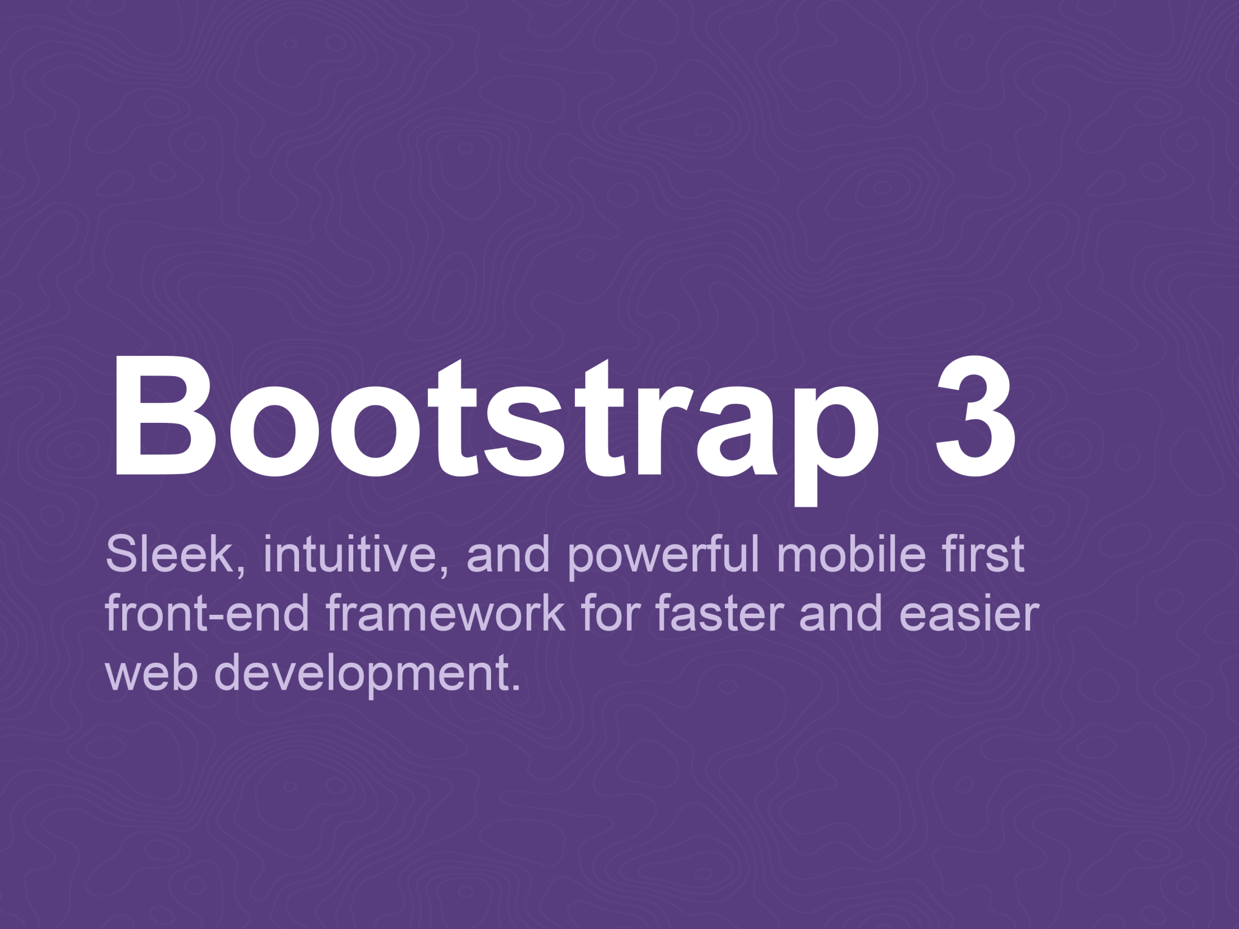

Slide 2
What is Bootstrap?
Bootstrap is a free front-end framework for faster and easier web development
Bootstrap includes HTML and CSS based design templates for typography, forms, buttons, tables, navigation, modals, image carousels and many other, as well as optional JavaScript plugins
Bootstrap also gives you the ability to easily create responsive designs

Slide 3
Responsive Web Design
“
Responsive web design is about creating web sites which automatically adjust themselves to look good on all devices, from small phones to large desktops.
”

Slide 4
What is Bootstrap?
An open source project by Mark Otto and Jacob Thornton who, when it was initially released, were both employees at Twitter
UI framework (set of JavaScript, CSS, and images)
Supported by all major browsers (yes, IE7 included)
Released in August 2011 (current version 3.3.5)

Slide 5
Advantages of Bootstrap?
Easy to use: Anybody with just basic knowledge of HTML and CSS can start using Bootstrap
Responsive features: Bootstrap's responsive CSS adjusts to phones, tablets, and desktops
Mobile-first approach: In Bootstrap 3, mobile-first styles are part of the core framework
Browser compatibility: Bootstrap is compatible with all modern browsers (Chrome, Firefox, Internet Explorer, Safari, and Opera)

Slide 6
Bootstrap Features
Supports HTML5 and CSS3
Responsive Design
Multi platform support (Mobile phones, Tablets, Laptops, Large screens)
Grid System
Predefined CSS Components
Javascript plugins
Web-based customization

Slide 7
What’s Included
This is the most basic form of Bootstrap: compiled files for quick drop-in usage in nearly any web project
Note that all JavaScript plugins require jQuery to be included
Bootstrap/
├── css/
├── bootstrap.css
├── bootstrap.min.css
├── bootstrap-theme.css
├── bootstrap-theme.min.css
├── js/
├── bootstrap.js
├── bootstrap.min.js
└── fonts/
├── glyphicons-halflings-regular.eot
├── glyphicons-halflings-regular.svg
├── glyphicons-halflings-regular.ttf
└── glyphicons-halflings-regular.woff

Slide 8
Getting Started
Getting started with Bootstrap is as simple as dropping some CSS and JavaScript into the root of your site: http://getbootstrap.com/getting-started/
Customize variables, components, JavaScript plugins, and more: http://getbootstrap.com/customize/

Slide 9
HTML5 Doctype
Bootstrap makes use of certain HTML elements and CSS properties that require the use of the HTML5 doctype
<!DOCTYPE html>
<html lang="en">
...
</html>

Slide 10
Mobile first
Bootstrap 3 is mobile first.
To ensure proper rendering and touch zooming, add the viewport meta tag:
Disable zooming capabilities on mobile devices by adding user-scalable=no:
<meta name="viewport" content="width=device-width, initial-scale=1.0">
<meta name="viewport" content="width=device-width, initial-scale=1.0, maximum-scale=1.0, user-scalable=no">

Slide 11
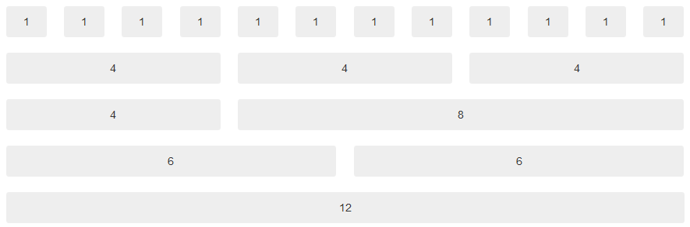
The Grid System
Bootstrap includes a responsive, mobile first fluid grid system that appropriately scales up to 12 columns as the device or viewport size increases.

Slide 12
Containers
Use .container for a responsive fixed width container.
Use .container-fluid for a full width container, spanning the entire width of your viewport.
<div class="container">
...
</div>
<div class="container-fluid">
...
</div>

Slide 13
Rows and Columns
Use .row to declare a row inside your container
Use .col-[xs, sm, md, lg] to declare columns depending on the viewport
<div class="row">
...
</div>
<div class="col-xs col-sm col-md col-lg">
...
</div>

Slide 14
Typography
Bootstrap's global default font-size is 14px, with a line-height of 1.428
This is applied to the <body> and all paragraphs.
<p> (paragraphs) receive a bottom margin of half their computed line-height (10px by default)

Slide 15
Headers
h1 Bootstrap heading (36px)
h2 Bootstrap heading (30px)
h3 Bootstrap heading (24px)
h4 Bootstrap heading (18px)
h5 Bootstrap heading (14px)
h6 Bootstrap heading (12px)

Slide 16
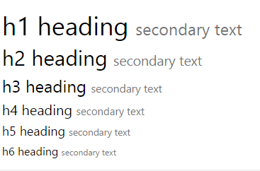
< small >
In Bootstrap the HTML <small> element is used to create a lighter, secondary text in any heading:
<h1>h1 heading <small>secondarytext</small></h1>

Slide 17
Typography
Headings <h1> to <h6>
Body copy <p>, .lead
Inline text elements <mark> <del> <ins>
Alignment classes .text-[left, center, right, justify, nowrap]
Transformation classes .text-[lowercase, uppercase, capitalize]
Abbreviations <abbr>, .initialism
Addresses <address>
Blockquotes <blockquote>
Lists <ul>, <ol>

Slide 18
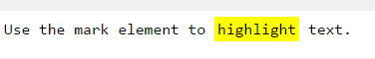
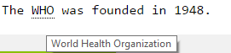
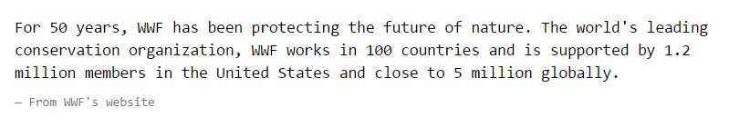
<mark>, <abbr>, <blockquote>
<mark>highlight</mark>
<abbr title="World Health Organization">WHO</abbr>
<blockquote>
<p>Some test</p>
<footer>From WWF's website</footer>
</blockquote>
Use .blockquote-reverse to show the quote to the right

Slide 19
Code
Inline <code>
User input <kbd>
Basic block <pre>
Variables <var>
Sample output <samp>
<code>Sample</code>
<kbd>ctrl</kbd> + <kbd>alt</kbd> + <kbd>del</kbd>
<pre>&lt;p&gt;Sample text here&lt;/p&gt;</pre>
<var>z</var> = <var>x</var> + <var>y</var>
<samp>Sample output from a program</samp>

Slide 20
Contextual Colors and Backgrounds
The classes for text colors are: .text-muted, .text-primary, .text-success, .text-info, .text-warning, and .text-danger
The classes for background colors are: .bg-primary, .bg-success, .bg-info, .bg-warning, and .bg-danger

Slide 21
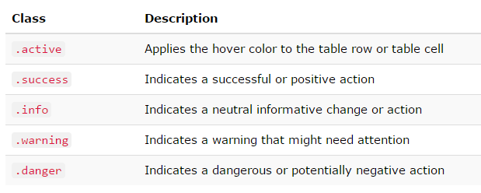
Contextual Classes

Slide 22
Tables
Basic .table
Striped rows .table-striped
Bordered table .table-bordered
Hover rows .table-hover
Condensed table .table-condensed
Responsive table .table-responsive
<table class="table">
...
</table

Slide 23
Buttons
Button tags <a> <button> <input>
Options .btn-[default, primary, success, info, warning, danger, link]
Sizes .btn-[lg, sm, xs]
Active state .active
Disabled state .disabled
<a class="btn" href="#" role="button">Link</a>
<button class="btn">Button</button>
<input class="btn" type="button" value="Input">
<input class="btn" type="submit" value="Submit">

Slide 24
Button Group
Bootstrap allows you to group a series of buttons together (on a single line) in a button group
Use a <div> element with class .btn-group to create a button group
Use the class .btn-group-vertical to create a vertical button group
<div class="btn-group"> <button type="button" class="btn btn-primary">Apple</button> <button type="button" class="btn btn-primary">Samsung</button> <button type="button" class="btn btn-primary">Sony</button> </div>

Slide 25
Button Group
<div class="btn-group"> <button type="button" class="btn btn-primary">Apple</button> <button type="button" class="btn btn-primary">LG</button> <div class="btn-group"> <button type="button" class="btn btn-primary dropdown-toggle" data-toggle="dropdown"> Sony <span class="caret"></span></button> <ul class="dropdown-menu" role="menu"> <li><a href="#">Tablet</a></li> <li><a href="#">Smartphone</a></li> </ul> </div> </div>

Slide 26
Glyphicons
Bootstrap provides 260 glyphicons from the Glyphicons Halflings set.
Glyphicons can be used in text, buttons, toolbars, navigation, forms, etc.
<span class="glyphicon glyphicon-name"></span>
<p>Search icon on a button: <button type="button" class="btn btn-default"> <span class="glyphicon glyphicon-search"></span>
Search </button> </p>

Slide 27
Badges
Badges are numerical indicators of how many items are associated with a link:
Use the .badge class within <span> elements to create badges
<a href="#">News <span class="badge">5</span></a> <br /> <a href="#">Comments <span class="badge">10</span></a> <br /> <a href="#">Updates <span class="badge">2</span></a>
<button type="button" class="btn btn-primary"> Primary <span class="badge">7</span></button>

Slide 28
Labels
Labels are used to provide additional information about something
Use the .label class, followed by one of the six contextual classes .label-default, .label-primary, .label-success, .label-info, .label-warning or .label-danger, within a <span> element to create a label
<h1>Example <span class="label label-default">New</span> </h1>
<h2>Example <span class="label label-default">New</span> </h2>
<span class="label label-default">Default Label</span> <span class="label label-primary">Primary Label</span>

Slide 29
Responsive images
Images in Bootstrap 3 can be made responsive-friendly via the addition of the .img-responsive class. This applies maxwidth: 100%; and height: auto; to the image so that it scales nicely to the parent element.
<img src="..." class="img-responsive" alt="responsive image" />

Slide 30
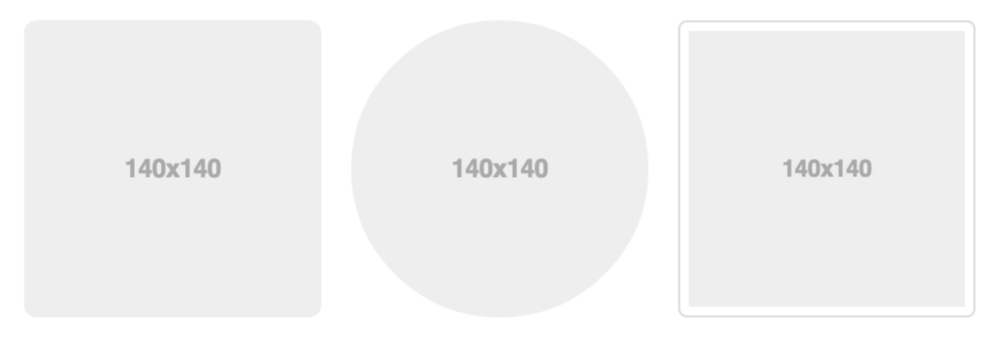
Image shapes
Add classes to an <img> element to easily style images in any project:
<img src="..." alt="..." class="img-rounded">
<img src="..." alt="..." class="img-circle">
<img src="..." alt="..." class="img-thumbnail">

Slide 31
Alerts
Alerts are created with the .alert class, followed by one of the four contextual classes .alert-success, .alert-info,.alert-warning or .alert-danger
Add class="close" and data-dismiss="alert" to a link or a button element
The .fade and .in classes adds a fading effect when closing the alert message
<div class="alert alert-success fade in">
<a href="#" class="close" data-dismiss="alert" aria-label="close">&times;</a>
<strong>Success!</strong> This alert box could indicate a successful or positive action.
</div>

Slide 32
Bootstrap Panel
A panel in bootstrap is a bordered box with some padding around its content
Panels are created with the .panel class, and content inside the panel has a .panel-body class
The .panel-heading class adds a heading to the panel
The .panel-footer class adds a footer to the panel:
To group many panels together, wrap a <div> with class .panel-group around them
The .panel-group class clears the bottom-margin of each panel

Slide 33
Bootstrap Panel
<div class="panel-group">
<div class="panel panel-default">
<div class="panel-heading">Panel Header</div>
<div class="panel-body">Panel Content</div>
</div>
<div class="panel panel-default">
<div class="panel-heading">Panel Header</div>
<div class="panel-body">Panel Content</div>
</div>
<div class="panel panel-default">
<div class="panel-heading">Panel Header</div>
<div class="panel-body">Panel Content</div>
<div class="panel-footer">Panel Footer</div>
</div>
</div>

Slide 34
Forms
Basic form <formgroup>
Inline form .form-inline
Horizontal form .form-horizontal
Supported controls
Static control .form-control-static
Control states :focus, #disabledInput, readonly
Validation states .has-[success, warning, error]
Control sizing -sm, -md, -lg
Help text .helpBlock

Slide 35
Bootstrap Forms
Form controls automatically receive some global styling with Bootstrap:
All textual <input>, <textarea>, and <select> elements with class .form-control have a width of 100%
Bootstrap provides three types of form layouts:
Vertical form (this is default)
Horizontal form
Inline form
Standard rules for all three form layouts:
Always use <form role="form"> (helps improve accessibility for people using screen readers)
Wrap labels and form controls in <div class="form-group"> (needed for optimum spacing)
Add class .form-control to all textual <input>, <textarea>, and <select> elements

Slide 36
Bootstrap Forms
<form role="form"> <div class="form-group"> <label for="email">Email address:</label> <input type="email" class="form-control"
id="email" /> </div> <div class="form-group"> <label for="pwd">Password:</label> <input type="password" class="form-control"
id="pwd" /> </div> <div class="checkbox"> <label><input type="checkbox"> Remember me </label> </div> <button type="submit" class="btn btn-default"> Submit</button> </form>

Slide 37
Bootstrap Forms
In an inline form, all of the elements are inline, left-aligned, and the labels are alongside.
(Note: This only applies to forms within viewports that are at least 768px wide!)
Add class .form-inline to the <form> element
Bootstrap supports the following form controls: input, textarea, checkbox, radio, select
<div class="form-group">
<label class="control-label col-sm-2" for="pwd">Password:</label>
<div class="col-sm-10">
<input type="password" class="form-control" id="pwd" placeholder="Enter password" />
</div>
</div>

Slide 38
Other Components
Navs
Navbar
Glyphicons
Dropdowns
Button groups
Button dropdowns
Input groups
Breadcrumbs
Pagination
Labels
Badges
Jumbotron
Page headers
Thumbnails
Alerts
Progress bars
Media object
List groups

Slide 39
Why Use Bootstrap?
Great Features
Responsive Design
Easy to customize
Fluid grid layout
Cross-browser compatibility
Big community

Slide 40
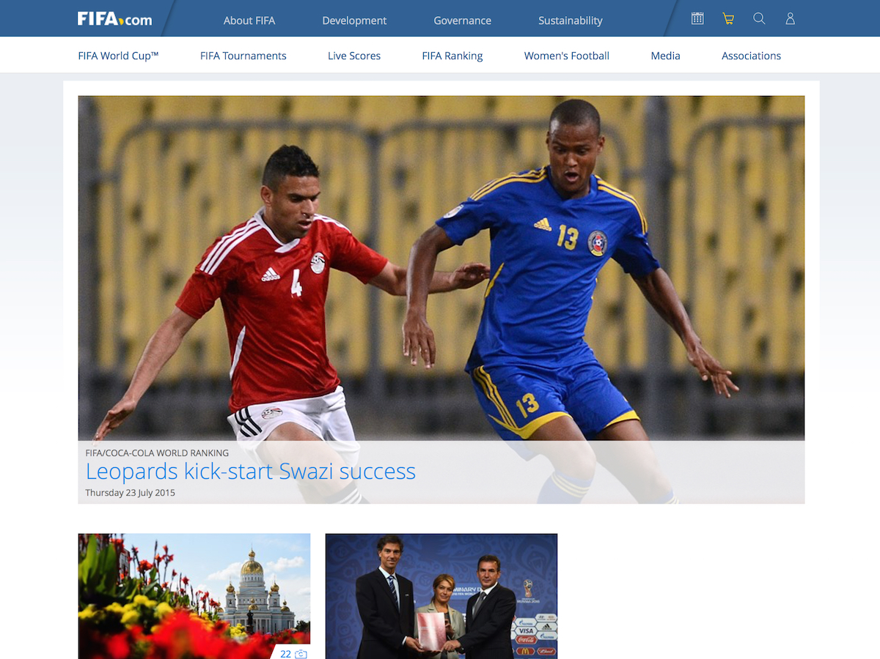
Sites Powered by Bootstrap

Slide 41
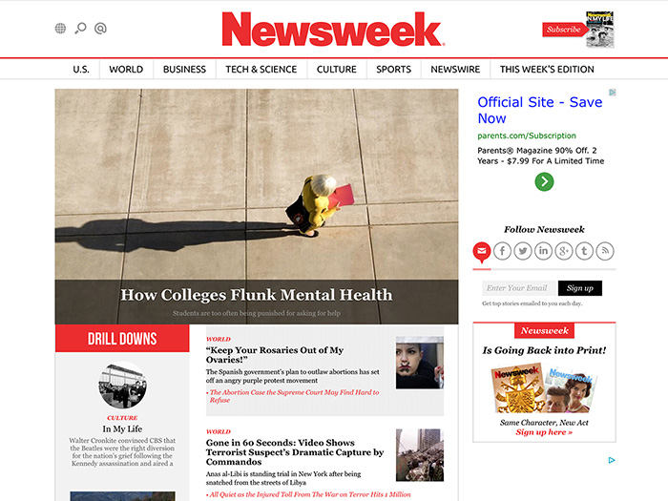
Sites Powered by Bootstrap

Slide 42

Sites Powered by Bootstrap

Slide 43
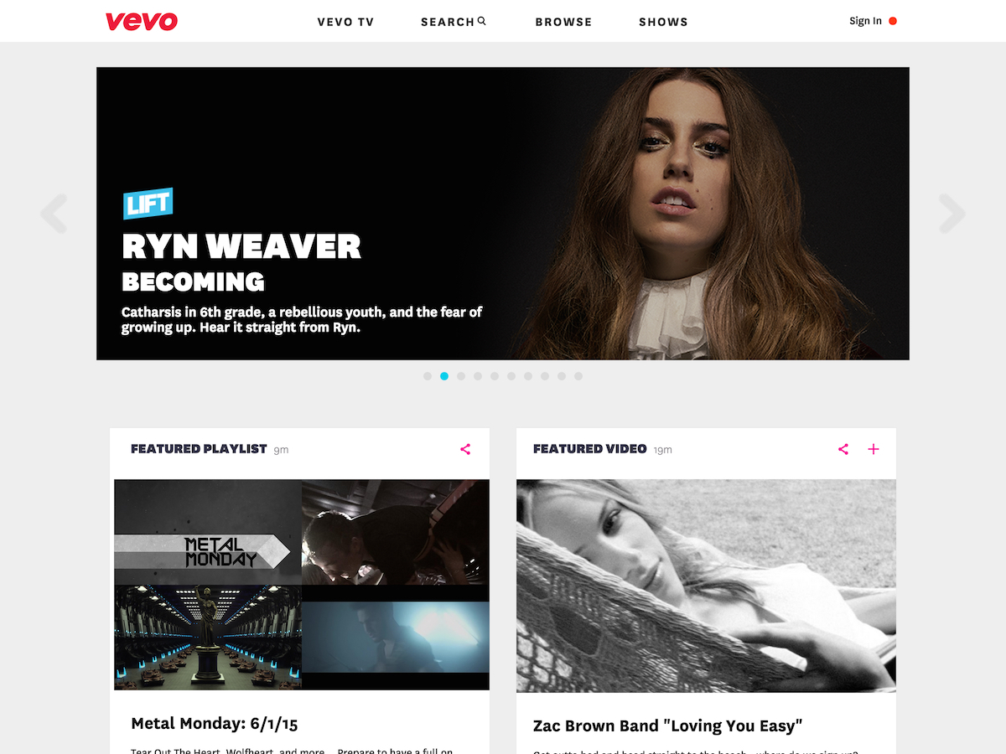
Sites Powered by Bootstrap

